Slide 1

PROJECT TITLE – HEALTHCARE ANALYTICS FOR DOCTOR VISITS_TIRTC
Name – PAYAL PANIGRAHI

Slide 2

PROBLEM STATEMENT
The objective of this project is to analyze healthcare data to identify the key factors influencing doctor visits. Using a dataset of 5,190 records, the project examines how age, gender, income, illness, health conditions, and insurance coverage affect healthcare utilization. Through Python-based data analysis and visualization, the project aims to identify meaningful patterns and provide data-driven insights into patient healthcare needs.

Slide 3
Project Description
This project focuses on analyzing healthcare data to understand the factors influencing doctor visits. Using Python, Pandas, Matplotlib, and Seaborn, the project explores patient demographics, health conditions, income, and insurance coverage. Data cleaning, exploratory data analysis (EDA), and visualizations are used to identify patterns and trends. The project aims to provide meaningful insights into healthcare utilization and support data-driven decision-making.

Slide 4

WHO ARE THE END USERS?
Hospitals and Clinics – To improve patient care and services.
Doctors – To understand patient health trends.
Healthcare Administrators – To manage hospital resources.
Healthcare Researchers – To study healthcare patterns.
Healthcare Policymakers – To improve healthcare planning.

Slide 5

Technology Used
  Python
  Pandas
  NumPy
  Matplotlib
  Seaborn

Slide 6
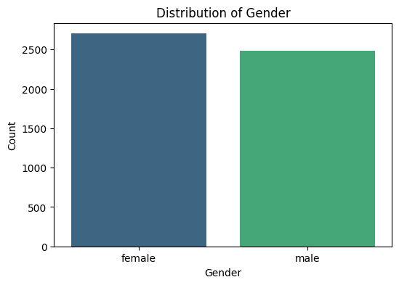
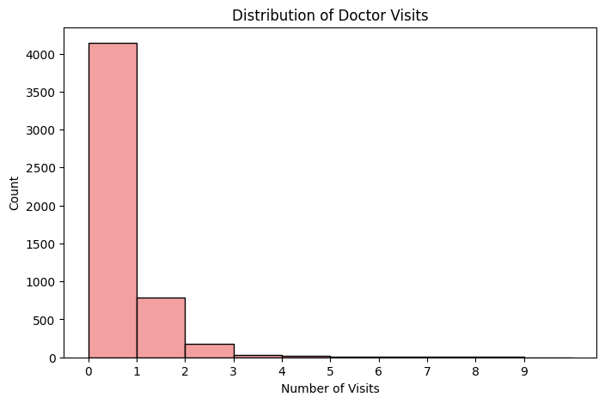
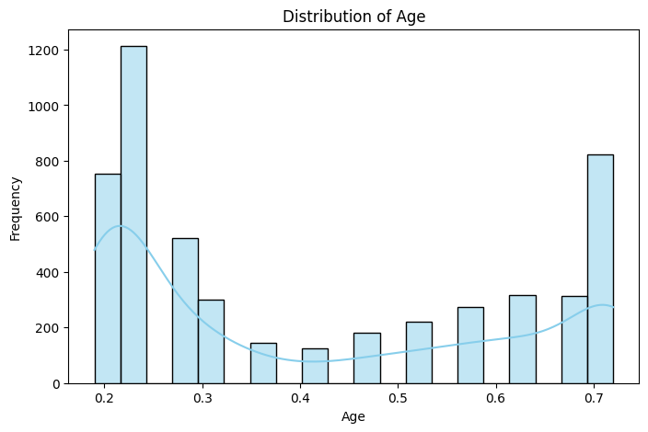
RESULTS
[Add screen shots of your code ]

Slide 7
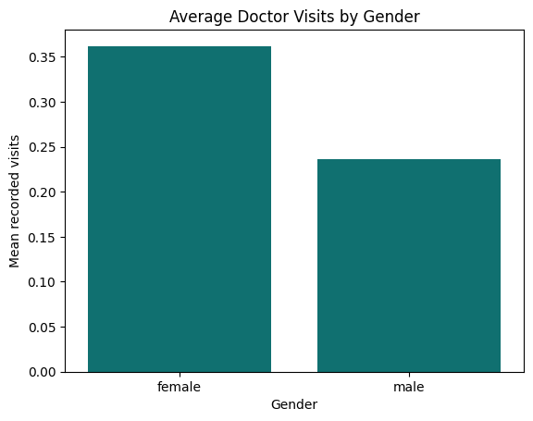
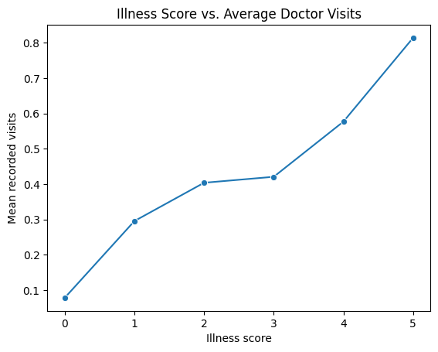
RESULTS

Slide 8
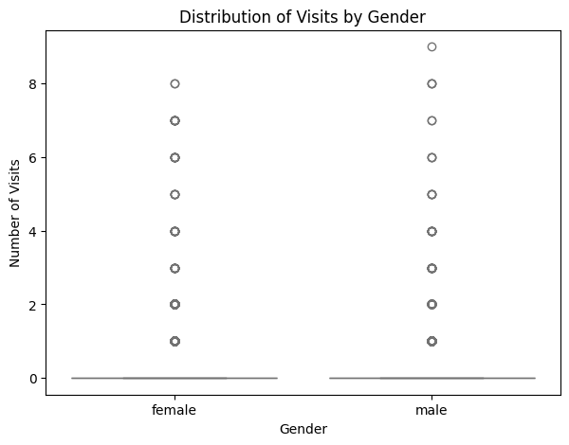
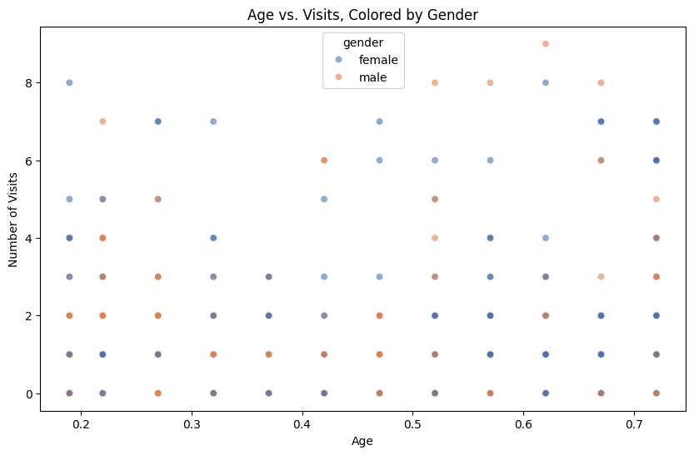
RESULTS

Slide 9
FUTURE SCOPE
The project can be improved by using Machine Learning to predict doctor visits and identify healthcare trends. It can also include more patient data and interactive dashboards for better analysis. The main advantages of this project are understanding patient needs, identifying healthcare patterns, improving hospital planning, and supporting better decision-making through data analysis.

Slide 10
GitHub Link
https://github.com/payal941/ Healthcare Analytics For Doctor Visits_TIRTC.git
Demo Link

Slide 11
Thank you
.
.

